Slide 1

WEB TECHNOLOGIES
HTML – Forms
Vinay Joshi
Department of
Computer Science and Engineering

Slide 2

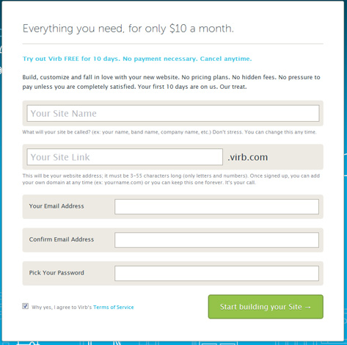
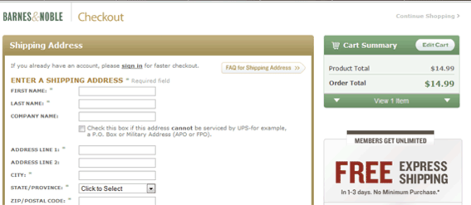
HTML – Forms
Introduction

Slide 3
HTML – Forms
Introduction
A form is a way to send information from a browser to a server
All the components of a form appear as the content of <form> tag
The components are called widgets (e.g., text boxes, radio buttons and checkboxes)
<form> is a HTML element to collect input data with containing interactive controls.
It provides facilities to input text, number, values, email, password, and control fields such as checkboxes, radio buttons, submits buttons, etc.
or in other words, form is a container that contains input elements, like text, email, number, radio buttons, checkboxes, submit buttons, etc

Slide 4
HTML – Forms
Input widgets
The <input> Element
The HTML <input> element is the most used form element.
An <input> element can be displayed in many ways, depending on the type attribute.

Slide 5
HTML – Forms
Input widgets
Input widget can be any of the following types
Text
Textarea
Button
Checkboxes
Radio Buttons
Dropdown list
Hidden

Slide 6
HTML – Forms
Input widgets
The <label> Element
Notice the use of the <label> element in the example above.
The <label> tag defines a label for many form elements.
The <label> element is useful for screen-reader users, because the screen-reader will read out loud the label when the user focus on the input element.

Slide 7
HTML – Forms
Attributes
Syntax:
<form list_of_attributes_and_values>
<input element>
…
</form>
Important attributes of the <form> tag
Method
Action
Target
Example:
<form method=“post” action=“survey.php” target=“_blank”>
<input type=“text”>
…
</form>

Slide 8
HTML – Forms
Introduction
action attribute specifies the URL of the application to be called when the Submit button is clicked (ex. action = http://www.cs.ucp.edu/cgi-bin/survey.pl)
no action, i.e. the value of action is the empty string or missing, then no request is sent on clicking the button
The method attribute of <form> specifies one of the two possible techniques of transferring the form data to the server, get and post
get and post are discussed in Chapter 10

Slide 9
HTML – Forms
Input widgets
<form>
<!--form elements-->
</form>
Form elements
These are the following HTML <form> elements:
<label>: It defines label for <form> elements.
<input>: It is used to get input data from the form in various type such as text, password, email, etc by changing it’s type.
<button>: It defines a clickable button to control other elements or execute a functionality.
<select>: It is used to create a drop-down list.
<textarea>: It is used to get input long text content.
<fieldset>: It is used to draws a box around other form elements and group the related data.

Slide 10
HTML – Forms
Input widgets
Textbox in HTML Form
Syntax:
<input type="text" />
In an HTML form, we use <input> tag by assigning type attribute value to text to input single line input. To define type attribute see the below syntax.
Tip: The default value of the type attribute is “text”.
Default size is 20;
If you don’t want to allow the user to type more characters than will fit, set maxlength, which causes excess input to be ignored
<input type = "text" name = "Phone"
size = "12" >

Slide 11
HTML – Forms
Input widgets
Password in an HTML Form
We can change type value text to password to get the input password .
<p>
<label>Password : <input type="password" /></label>
</p>

Slide 12
HTML – Forms
Input widgets: Submit
Submit button in an HTML Form
In the HTML form, submit button is used to submit the details of the form to the form handler. A form handler is a file on the server with a script that is used to process input data.
Syntax:
<button type="submit">submit</button>

Slide 13
HTML – Forms
Input widgets
<!DOCTYPE html>
<html>
<head>
<title>Page Title</title>
</head>
<body>
<h2>Welcome To GFG</h2>
<form>
<p>
<label>Username : <input type="text" /></label>
</p>
</form>
</body>
</html>
<p>
<label>Password : <input type="password" /></label>
</p>

Slide 14
HTML – Forms
Input widgets: Radio Button
Radio Button in an HTML Form
To create a radio button, we use the <input> tag following by radio type to provide users to choose a limited number of choices.
Syntax:
<input type="radio" name="radio_button_name“ value="radio_button_value" />

Slide 15
HTML – Forms
Input widgets: Radio button
!DOCTYPE html>
<html>
<head>
<title>Page Title</title>
</head>
<body>
<h2>Select your gender</h2>
<form>
<label>Male<input type="radio" name="gender" value="male" /></label>
<label>Female<input type="radio" name="gender" value="female" /></label>
</form>
</body>
</html>

Slide 16
Forms (continued)
Radio Buttons (continued)
If no button in a radio button group is ‘pressed’, the browser often ‘presses’ the first one
Age Category
<form action = "">
<p>
<input type = "radio" name = "age"
value = "under20" checked = "checked"> 0-19
<input type = "radio" name = "age"
value = "20-35"> 20-35
<input type = "radio" name = "age"
value = "36-50"> 36-50
<input type = "radio" name = "age"
value = "over50"> Over 50
</p>
</form>

Slide 17
HTML – Forms
Input widgets: Radio button
Checkbox in an HTML Form
To create a checkbox in an HTML form, we use the <input> tag following by the input type checkbox. It is a square box to ticked to activate this. It used to choose more options at a time.
<input type="checkbox" name="select_box_name" value="select_box_value" />
A checkbox allows you to choose one or many options to be selected from a list of options.

Slide 18
HTML – Forms
Input widgets: Check box
<form>
Choose languages you know:
<br>
<input type="checkbox"
name="C"
value="yes">C
<br>
<input type="checkbox"
name="C++"
value="yes">C++
<br>

Slide 19
HTML – Forms
Input widgets: Check box
<input type="checkbox"
name="Java"
value="yes">Java
<br>
<input type="checkbox"
name="Python"
value="yes">Python
<br>

Slide 20
Forms (continued)
Checkboxes - to collect multiple choice input
Every checkbox requires a value attribute, which is the widget’s value in the form data when the checkbox is ‘checked’
A checkbox that is not ‘checked’ contributes no value to the form data
By default, no checkbox is initially ‘checked’
To initialize a checkbox to ‘checked’, the checked attribute must be set to "checked“
Radio button:It is a single control unit.
Checkbox:It is a multiple control unit.

Slide 21
Forms (continued)
Widgets (continued)
Grocery Checklist
<form action = "">
<p>
<input type = "checkbox" name ="groceries"
value = "milk" checked = "checked">
Milk
<input type = "checkbox" name ="groceries"
value = "bread">
Bread
<input type = "checkbox" name = "groceries"
value= "eggs">
Eggs
</p>
</form>

Slide 22
HTML – Forms
Input widgets: Text areas
Text areas - created with <textarea>
Usually include the rows and cols attributes to specify the size of the text area
Default text can be included as the content of <textarea>
Scrolling is implicit if the area is overfilled
Please provide your employment aspirations
<form action = "">
<p>
<textarea name = "aspirations" rows = "3” cols = "40">
(Be brief and concise)
</textarea>
</p>
</form>

Slide 23
HTML – Forms
Input widgets: email and Date
<p>
<label>Email:<input type="email" name="email" /></label>
</p>
<p>
<label>Date of Birth:<input type="date name="birthDate">
</label>
</p>
<p>

Slide 24
HTML – Forms
Input widgets: Drop Down list
The <select> element is used to create a drop-down list.
The <select> element is most often used in a form, to collect user input.
The name attribute is needed to reference the form data after the form is submitted (if you omit the name attribute, no data from the drop-down list will be submitted).
The <option> tags inside the <select> element define the available options in the drop-down list.

Slide 25
HTML – Forms
Input widgets: Drop Downlist
<form>
<label for="lang">Language</label>
<select name="languages" id="lang">
<option value="javascript">JavaScript</option>
<option value="php">PHP</option>
<option value="java">Java</option>
<option value="golang">Golang</option>
<option value="python">Python</option>
<option value="c#">C#</option>
<option value="C++">C++</option>
<option value="erlang">Erlang</option>
</select>
<input type="submit" value="Submit" />
</form>

Slide 26
HTML – Forms
Input widgets: Menus
Each item of a menu is specified with an <option> tag, whose pure text content (no tags) is the value of the item
An <option> tag can include the selected attribute, which when assigned "selected” specifies that the item is preselected
Grocery Menu - milk, bread, eggs, cheese
<form action = "">
<p>
With size = 1 (the default)
<select name = "groceries">
<option> milk </option>
<option> bread </option>
<option> eggs </option>
<option> cheese </option>
</select>
</p>
</form>

Slide 27
Forms (continued)
Widgets (continued)
After clicking the menu:
After changing size to 2:

Slide 28
HTML – Forms
Input widgets: Menus
Reset and Submit buttons
Both are created with <input>
<input type = "reset" value = "Reset Form">
<input type = "submit” value = "Submit Form">
Submit has two actions:
Encode the data of the form
Request that the server execute the server-resident program specified as the value of the action attribute of <form>
A Submit button is required in every form

Slide 29
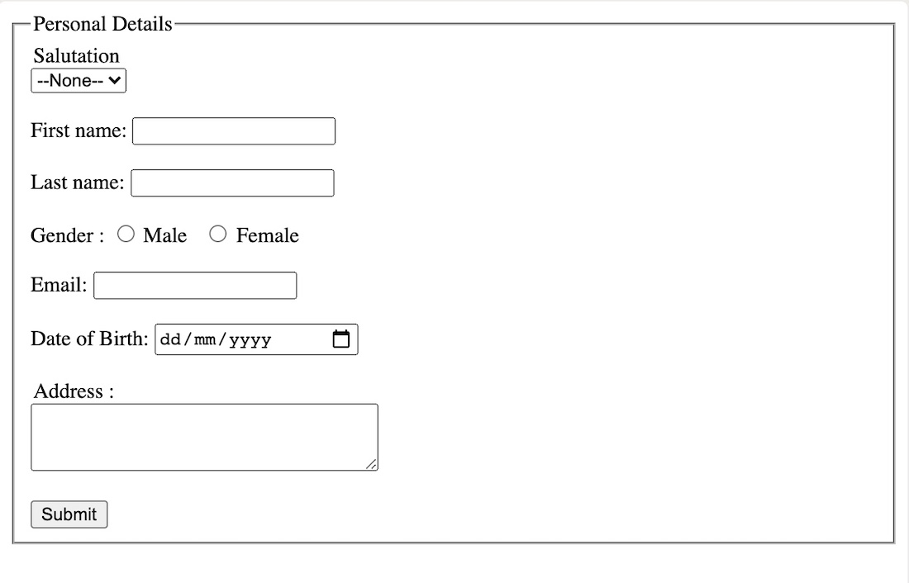
HTML – Forms
Create a web page

Slide 30
HTML – Forms
HTML5 – New Input widgets
HTML5 specifications introduced new Input types
email : email address
number: spinbox
range: slider
url: web addresses
color: color pickers
search: search boxes
date: date
month: month
time: time
week: week
datetime: combination of date and time.

Slide 31
HTML5: Input - e-mail
The email type is used for input fields that should contain an e-mail address.
The value of the email field is automatically validated when the form is submitted.
E-mail: <input type="email" name="user_email" />

Slide 32
HTML5: Input - url
The url type is used for input fields that should contain a URL address.
The value of the url field is automatically validated when the form is submitted.
Homepage: <input type="url" name="user_url" />

Slide 33
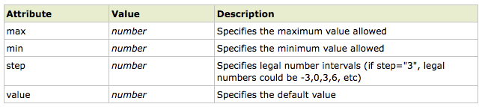
HTML5: Input - number
The number type is used for input fields that should contain a numeric value.
Set restrictions on what numbers are accepted:
Points: <input type="number" name="points" min="1" max="10" />

Slide 34
HTML5: Input - range
The range type is used for input fields that should contain a value from a range of numbers.
The range type is displayed as a slider bar.
You can also set restrictions on what numbers are accepted:
<input type="range" name="points" min="1" max="10" />

Slide 35
HTML5: Input – date pickers
HTML5 has several new input types for selecting date and time:
> date - Selects date, month and year
> month - Selects month and year
> week - Selects week and year
> time - Selects time (hour and minute)‏
> datetime - Selects time, date, month and year. This is now obsolete
> datetime-local - Selects time, date, month and year (local time)‏

Slide 36
HTML5: Input - search
HTML5: Input - search
The search type is used for search fields like a site search or Google search.
The search field behaves like a regular text field.

Slide 37
HTML5: Input – color picker
HTML5: Input – color picker
The color type is used for input fields that should contain a color.
This input type will allow you to select a color from a color picker:
Color: <input type="color" name="user_color" />

Slide 38
THANK YOU
Vinay Joshi
Department of Computer Science and Engineering
vinayj@pes.edu
+91 80 2672 6622

